Slide 1
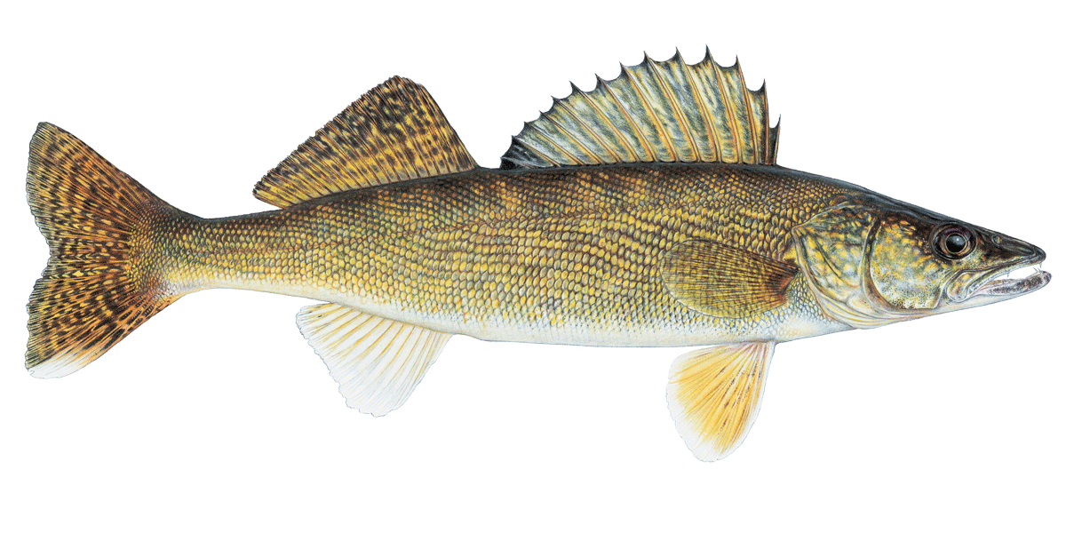
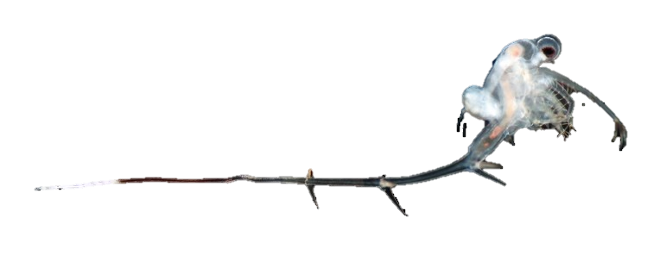
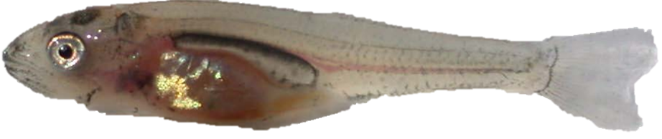
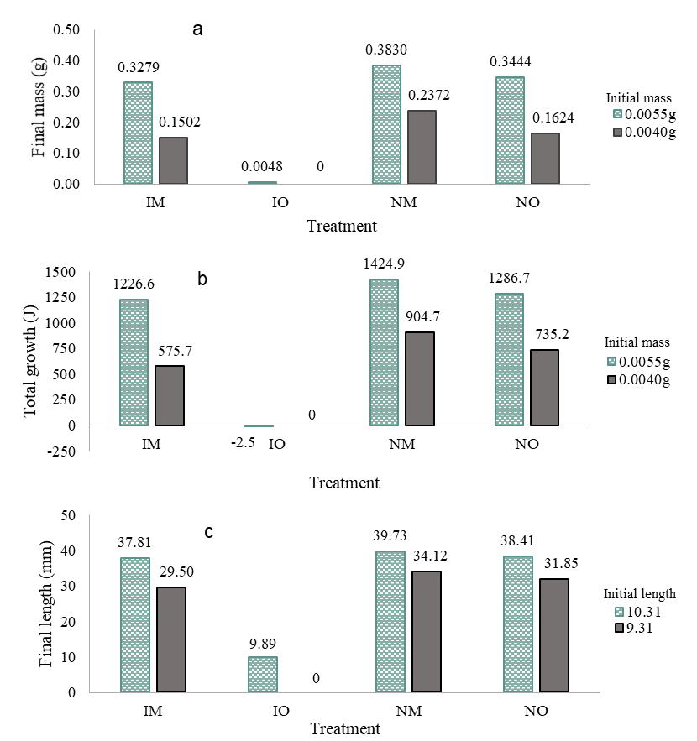
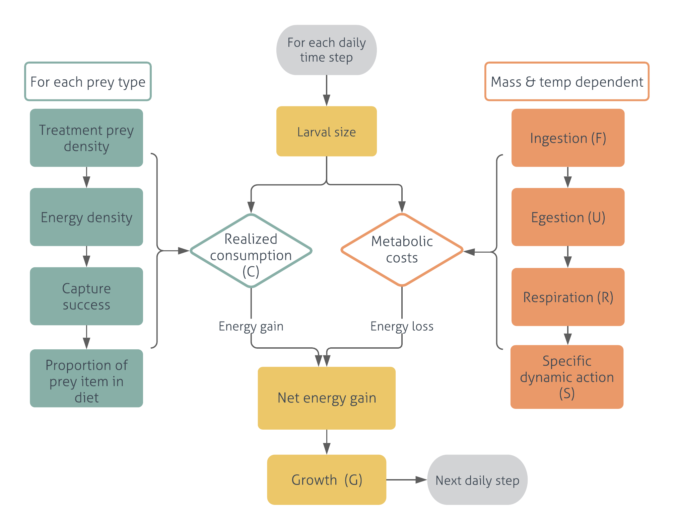
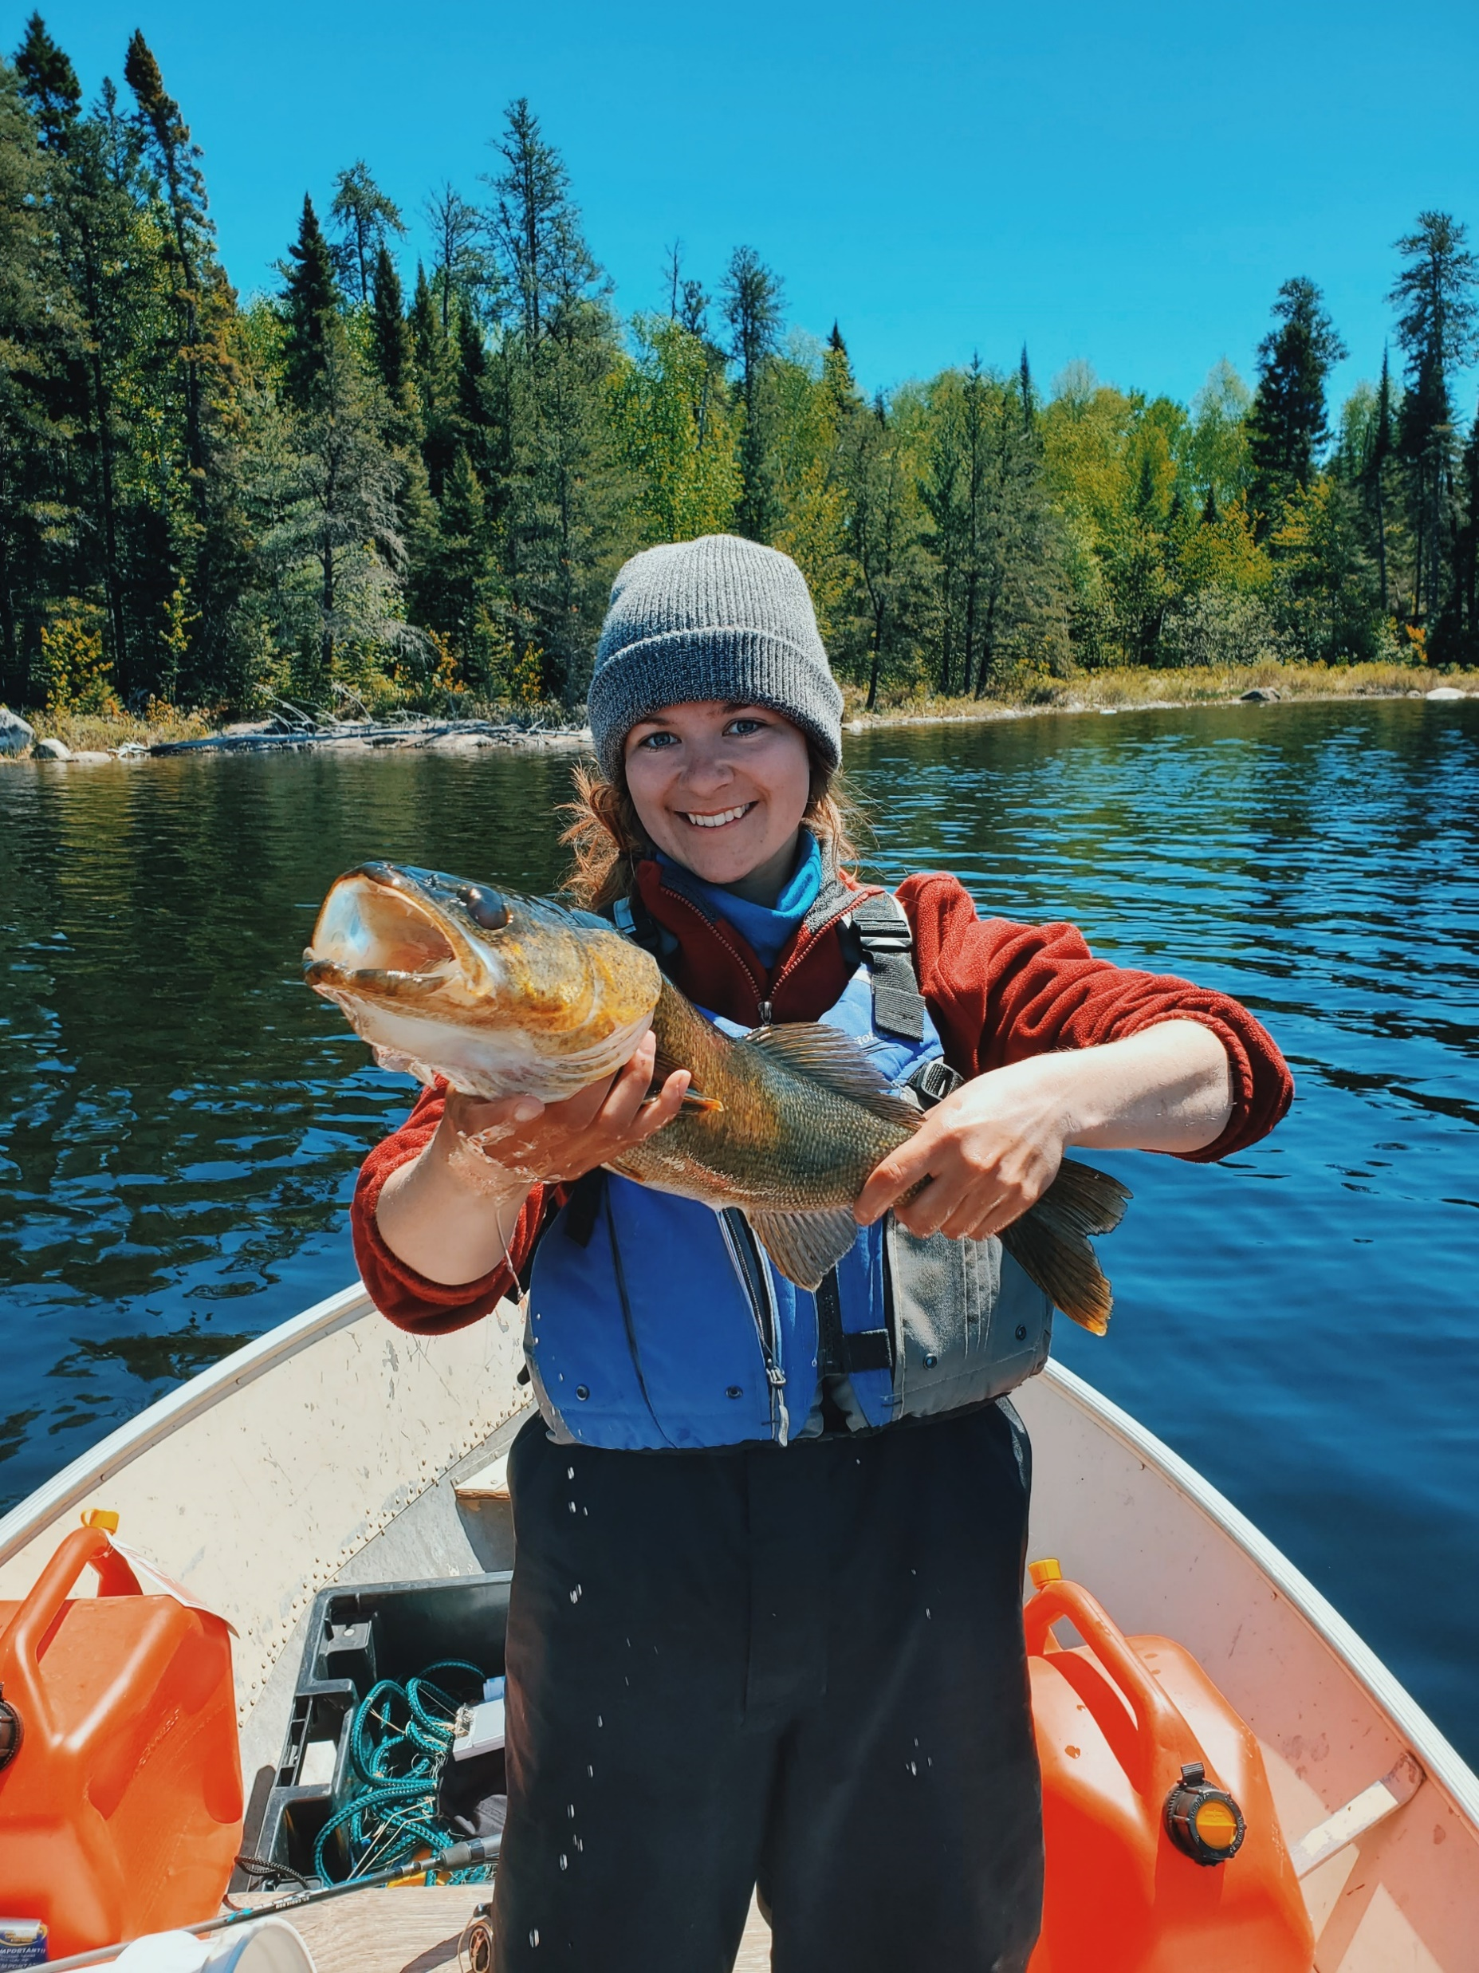


Danni Gartshore, and Michael Rennie Lakehead University, Thunder Bay ON dgartsho@lakeheadu.ca | mrennie@lakeheadu.ca
USING BIOENERGETICS MODELLING TO EVALUATE THE IMPACTS OF BYTHOTREPHES ON THE GROWTH OF LARVAL WALLEYE
Early life-history stages are large limiting factors to fish recruitment and may determine year-class strength, with prey availability (zooplankton) being one of the most critical factors to larval fish survival^{1,2}.
Invasive species, particularly Spiny Water flea (SWF,[Bythotrephes longimanus]) are known to cause rapid decreases to zooplankton biomass (sometimes 40-60%) in invaded lakes ³.
Walleye (Stizostedion vitreum) are zooplanktivorous at first feeding, experiencing multiple length-dependent ontogenetic diet shifts in their first year ^{4,5,6}. Since SWF invasions appear to limit zooplankton abundance and cannot be a prey item for larval walleye due to size (Fig 1), one might expect a decrease in prey consumption for larval walleye, leading to slower growth.
Predicted end of season young-of-year (YOY) walleye size has been found to be smaller in invaded lakes ⁷.
In this study, we used a bioenergetics model to evaluate whether a predicted decrease in prey availability due to SWF invasions was able to explain the degree and magnitude of changes in YOY walleye size observed in invaded lakes.
Table 1. Average biomass (µg/L) values of Daphnia, calanoids, and cyclopoids based on trophic and SWF invasion status used in this study.
Using a simple bioenergetic and functional response modelling framework, we demonstrated reduced growth rates of larval walleye are expected based on changes in prey (zooplankton) abundance associated with SWF invasions.
These findings match closely with a recent study that YOY walleye were 12.8% smaller in predicted length at the end of their first growing season in lakes invaded by SWF compared to non-invaded systems⁷.
Importantly, in oligotrophic lakes, our models only predicted walleye growth in certain circumstances, suggesting that lakes below a certain trophic status might be more vulnerable to the potential for recruitment failure due to SWF impacts.
Walleye typically grow to ~30mm within their first month³, and this occurred in all treatments except in oligotrophic lakes invaded with SWF, where consumption based on low prey availability was not sufficient to sustain metabolic costs (Fig 4c).
This is likely due to decreased availability of cyclopoids early in life resulting in insufficient growth to reach the length-dependent diet shifts to calanoids at 12mm or the more energy dense Daphnia at 18mm (Fig. 3).
Because gape is dependent on length, decreased growth due to low prey availability delays the timing of diet-shifts to larger and more energy dense prey. This also implies that ontogenetic diet-shifts to benthic invertebrates and ultimately piscivory later in their first year of growth may also be delayed ¹⁰.
This suggests that delayed diet shifts are energetically detrimental as the gape-limited larval walleye must consume the less energy dense prey item (zooplankton) for a longer period.
We propose to continue building this bioenergetics model to incorporate length-dependent diet shifts to benthic invertebrates and piscivory to determine how SWF invasions impact the timing of diet-shifts and the total growth of a young-of-year walleye.
Considering maturity of walleyes is typically defined by a maturity-at-length relationship, SWF invasion, lake trophic status, and smaller first feeding sizes may result in slower growing walleye, delaying age at maturation, or high larval mortality ¹². Delayed maturation reduces the proportion of fish spawning in the population, and will likely have negative impacts on future recruitment ¹³ .
Treatment | Invasion status | Trophic status | n | Daphnia (µg/L) | Calanoid (µg/L) | Cyclopoid (µg/L) | Total (µg/L)
NM | Non-invaded | Mesotrophic | 4 | 192.01 ± 1 | 69.86 ± 1 | 32.87 ± 1 | 294.75
NO | Non-invaded | Oligotrophic | 132 | 161.9 ± 442.2 | 52.51 ± 148.3 | 13.21 ± 20 | 227.71
IM | Invaded | Mesotrophic | 4 | 55.20 ± 1 | 75.23 ± 1 | 21.29 ± 1 | 151.72
IO | Invaded | Oligotrophic | 38 | 28.51 ± 65.21 | 14.13 ± 15.84 | 6.20 ± 7.13 | 48.85
Data sources for zooplankton biomass for mesotrophic lakes from Kerfoot et al. (2016), and oligotrophic lakes from Arnott [Unpublished data].
Figure 1. Size comparison of a larval walleye (Stizostedion vitreum) and the invasive species Bythotrephes longimanus, both range ~8-15mm.
The model allowed a diet shift in zooplankton type depending on length in which larvae consumed cyclopoids until they reached 12mm, then a mix of calanoid and cyclopoids until 18mm where Daphnia began to be the dominant prey item¹¹(Fig 3).
In the invaded oligotrophic (both initial masses), larval walleye never grew large enough (≥11mm) to shift diet (Fig 3&4).
Larval growth under non-invaded conditions was higher in both mesotrophic and oligotrophic lakes compared to both invaded treatments (Fig. 4), with the mesotrophic lakes providing the fastest larval growth (total growth =0.37g or 29.42mm).
Larval growth rates under the invaded-mesotrophic treatment were similar to the growth rates of the non-invaded oligotrophic treatment (Fig. 4).
Larval walleye successfully grew in all treatments except the invaded oligotrophic treatment (Fig. 4), where after 31 days larval walleye either did not survive (initial mass 0.004g or length 9.31mm) or only managed to grow to 0.0048g or 9.89mm (initial mass 0.0040g or length 10.31mm).
Overall, with SWF present, the final walleye larvae length was on average 9.68% and 118.0% shorter than non-invaded mesotrophic and oligotrophic systems respectively.
Bioenergetics models can be used to describe the energy budget of fishes, where energetic costs for metabolism, waste loss, and growth can be balanced against the energy consumed by an aquatic organism ⁸
To assess how larval walleye growth rate might change due to the impacts of SWF invasion on zooplankton community structure, we determined consumption based on zooplankton densities from various SWF-invaded and non-invaded lakes across Northern Ontario 4, Arnott [Unpublished raw data].
We simulated larval walleye growth under four different conditions: non-invaded mesotrophic lakes (NM), non-invaded oligotrophic lakes (NO), invaded mesotrophic lakes (IM), and invaded oligotrophic lakes (IO).
At first feeding, walleye typically weigh 0.004 - 0.0055g ^{9,10}, so each treatment was run at both these weights as the initial masses for a walleye larva to capture a range of initial larvae sizes.
Larval growth (G) was then determined through a daily energy budget equation below:
Figure 3. Length dependent diet shifts of a larval walleye indicating the proportion of each diet item (calanoids, cyclopoids, and Daphnia sp.). Prey capture success is plotted on the secondary axis.
G_{t} = C_{t} – R_{t} – F_{t} – U_{t} – S_{t}
This study aimed to determine if a change in zooplankton abundance due to SWF invasions will impact the growth rates of larval walleye.
Our data suggests that zooplankton densities in invaded less productive/oligotrophic lakes are insufficient for larval walleye growth.
In more productive/mesotrophic lakes, larval walleye growth is slower in invaded lakes but is comparable to that of a non-invaded oligotrophic lake.
Figure 4. Results of the bioenergetics model in this study showing a) the final mass (g) of larval walleye (initial mass of either 0.0055g or 0.0040g), b) total growth (J) of larval walleye (initial mass of either 0.0055g or 0.0040g), and c) final length (mm) of larval walleye (initial length of either 10.31mm or 9.31mm) with consumption varying based on zooplankton abundance treatments for 31 days: Invaded with SWF and mesotrophic (IM), invaded and oligotrophic (IO), not invaded and mesotrophic (NM), and not invaded and oligotrophic (NO).
Figure 2. Flow chart depicting the bioenergetics model used in this study for larval walleye. The model operates on a daily time step and provides the total growth, calculated by the difference in consumption energy gains, and metabolic energy losses. At the end of each daily time step, the growth (in g or mm) dictates the size of the larva for the next time step. Walleye specific parameters for the bioenergetics model are from Johnston 1999.
Bioenergetics models have been used in the past to determine changes in fish growth due to invasive species ^{11,12} but this is the first to evaluate the impacts of SWF invasions on larval walleye. We have linked observed decreases in growth rate of larval walleye to the decreased prey availability in SWF invaded lakes, expanding our knowledge on the impacts of invasive species to freshwater fisheries.
1.Grote JD, Wuellner MR, Blackwell BG, Lucchesi DO. Evaluation of potential overwinter mortality of age-0 walleye and appropriate age-1 sampling gear. J Fish Wildl Manag. 2018;9(1):65-74. doi:10.3996/082017-JFWM-062 2.Jonas JL, Wahl DH. Relative Importance of Direct and Indirect Effects of Starvation for Young Walleyes. Trans Am Fish Soc. 1998;127(2):192-205. doi:10.1577/1548-8659(1998)127<0192:riodai>2.0.co;2 3.Barbiero RP, Tuchman ML. Changes in the crustacean communities of Lakes Michigan, Huron, and Erie following the invasion of the predatory cladoceran Bythotrephes longimanus . Can J Fish Aquat Sci. 2004;61(11):2111-2125. doi:10.1139/F04-149 | 4.Kerfoot CW, Hobmeier MM, Yousef F, Lafrancois BM, Maki RP, Hirsch JK. A plague of waterfleas (Bythotrephes): impacts on microcrustacean community structure, seasonal biomass, and secondary production in a large inland-lake complex. Biol Invasions. 2016;18(4):1121-1145. doi:10.1007/s10530-015-1050-9 5.Gillis MK, Walsh MR. Rapid evolution mitigates the ecological consequences of an invasive species (Bythotrephes longimanus) in lakes in Wisconsin. Proc R Soc B Biol Sci. 2017;284(1858). doi:10.1098/rspb.2017.0814 | 6.Uphoff CS, Schoenebeck CW, Koupal KD, Pope KL, Hoback W. Age-0 walleye Sander vitreus display length-dependent diet shift to piscivory. J Freshw Ecol. 2019;34(1):27-36. doi:10.1080/02705060.2018.1529637 7.Hansen GJA, Ahrenstorff TD, Bethke BJ, et al. Walleye growth declines following zebra mussel and Bythotrephes invasion. Biol Invasions. 2020;22(4):1481-1495. doi:10.1007/s10530-020-02198-5 8. Deslauriers D, Chipps SR, Breck JE, Rice JA, Madenjian CP. Fish Bioenergetics 4.0: An R-Based Modeling Application. Fisheries. 2017;42(11):586-596. doi:10.1080/03632415.2017.1377558 | 9. Mathias JA, Li S. Feeding Habits of Walleye Larvae and Juveniles: Comparative Laboratory and Field Studies. Trans Am Fish Soc. 1982;111(6):722-735. doi:10.1577/1548-8659(1982)111<722:fhowla>2.0.co;2 10. Malison J a, Held J a, Program WA. Reproductive Biology and Spawning. Reprod Biol. Published online 1996:11-18. 11. Johnston, T.A. 1999. Factors affecting food consumption and growth of walleye, Stizostedion vitreum, larvae in culture ponds. Hydrobiologia 400: 129–140. doi:10.1023/A:1003755115000. 12. Rowe DK, Thorpe JE (1990) Suppression of Maturation in Male Atlantic Salmon (Sulmo salar L.) Parr by Reduction in Feeding and Growth During Spring Months. Aquaculture 86:291–313
Acknowledgements
We would like to thank Shelley Arnott and Alex Ross for providing us with zooplankton abundance data.

